Slide 2
Chapter 7
Virtualization Technology (At Network)

Slide 3
Learning Outcomes
Comprehend network virtualization
List the benefits of network virtualization
Explain the benefits of virtualization
Describe various network components
Understand traffic management techniques
Understand virtual machine migration services

Slide 4
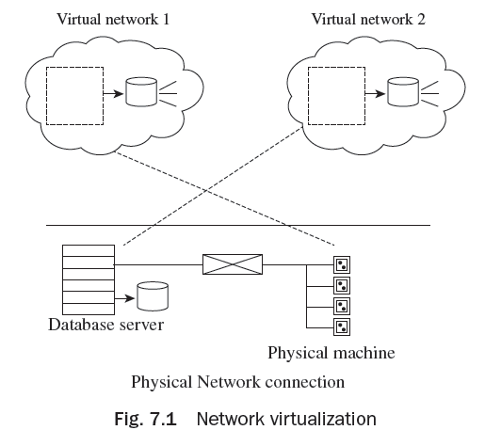
Exploring Network Virtualization
In network virtualization, multiple virtual networks run with the help of a
physical network as shown in Fig. 7.1.
Network virtualization comprises rationally
grouping and segmenting physical network
(s) into distinct rational units known as
‘virtual network(s)’ and forming them to act
as one or multiple separate network(s).
It permits multiple virtual networks to
share network resources.

Slide 5
Exploring Network Virtualization
In virtual data center (VDC), network virtualization comprises virtualization of both VM and physical networks.
The physical network may consist of network routers, hubs, switches, repeaters, adapters, and bridges.
A VM network exists within a physical server.
A computer on which a hypervisor runs one or more virtual machines is called a host machine, and each virtual machine is called a guest machine.
Network virtualization permits a manager to construct multiple virtual networks in the data center (DC).
A virtual network offers alignment of all the nodes which belong to a similar working unit in an enterprise.

Slide 6
Benefits of Network Virtualization
Reduction of hardware expense
Energy expenses
Recoverability
Disaster recuperation

Slide 7
Features of Network Components
Virtual Switches
Virtual LAN
Virtual Switches:
Virtual switches act as an interface between virtual ethernet and the physical ethernet. Virtual switches develop VM network and support the ethernet protocol as shown in Fig. 7.2.
They manage storage, administration, and VM migration traffic to and from the hypervisor kernel.
A virtual switch can have multiple port groups.

Slide 8
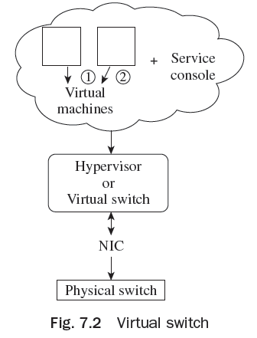
Features of Network Components
The IBM system Networking Distributed Virtual
Switch 5000V is a superior, feature rich distributed
virtual switch for VMware environments along
with policy-based VM associatively. The IBM
Distributed Virtual Switch (DVS) 5000V allows
network managers accustomed with IBM System.

Slide 9
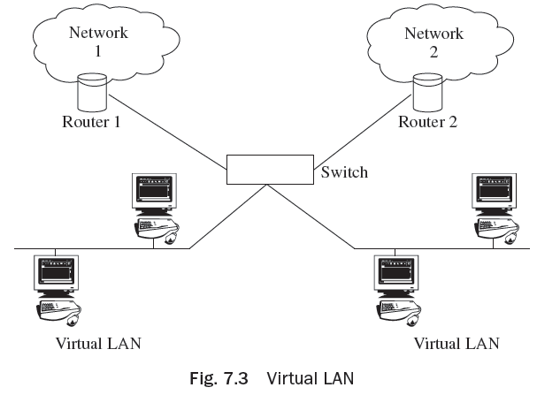
Features of Network Components
Virtual LAN allows one to have separate LANs among ports on the same switch.
VLAN trunking allows traffic from multiple VLANs to traverse a single network connection.
VLAN membership can be defined in several ways:
(a) Port-based
(b) Protocol-based
(c) MAC-layer grouping
(d) Network-layer grouping
(e) Multicast grouping
(f) Policy grouping

Slide 10
Traffic Management and its Techniques
Resource management of various resource instances between various users in a cloud computing environment as per user requirement is called traffic management.
Cloud computing is generally based on adaptive traffic management and control techniques.
In VDC, network managers have a suitable policy for allocation of network traffic across network connections and VMs.
Load balancing is one of the key matters in cloud computing. It is a procedure which allocates the extra dynamic regional workload consistently across all the nodes. It also assists in facilitating scalability, executing fail-over, and minimizing the response period preventing blockage and over-provisioning, and many more.

Slide 11
Traffic Management and its Techniques
The network governing skills are as follows:
1. Technique 1: Balancing client workload—hardware
2. Technique 2: Balancing client workload—software
3. Technique 3: Storm control
4. Technique 4: NIC teaming
5. Technique 5: Limit and share
6. Technique 6: Traffic shapping

Slide 12
Load Balancing in Cloud Computing
Load balancing that is presently prevalent in clouds is as follows:
Decentralized content alert load balancing
Server-based load balancing for Internet allocated services
Join–Idle–Queue
A lock-free multiprocessing for load balancing (LB)
Scheduling scheme on load balancing of virtual machine resources
Central load balancing policy for virtual machines (CLBVM)
Load balancing scheme for virtual storage (LBVS)
Task scheduling algorithm based on load balancing
Honeybee foraging behaviour

Slide 13
Load Balancing in Cloud Computing
Biased random sampling
Active clustering
Load balancing procedure based on ant colony and complex network theory (ACCLB)
Two-phase load balancing algorithm
Event-driven
Carton
Compare and balance
Overheads associated
Throughput
VectorDot

Slide 14
Virtual Machine Migration Services
VM migration is one of the vital strategies in the field of physical machine virtualization that
permits applications to be clearly moved with their implementation settings across physical
machines.
Virtual machine migration is required for server consolidation (power saving), resource
scheduling, and load balancing. For successful migration, interruption and migration time
should be minimized.
The various virtual machine migration methods are :
Fault Tolerant Migration
Load Balancing Migration
Energy Efficient Migration
Pre-copy-based migration
Post-copy-based migration

Slide 15
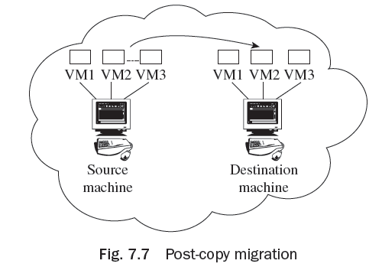
Virtual Machine Migration Services
Post-copy-based migration
The steps included in the post-copy technique are as follows:
1. The virtual machine is on the source machine.
2. The execution state of the virtual machine is
transferred before memory is transferred
and if the page generates page fault then the
requested page is transferred.
3. The virtual machine is activated on the target
machine, later.

Slide 16
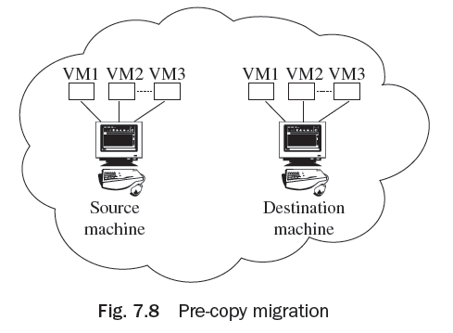
Virtual Machine Migration Services
Pre-copy-based migration
Pre-copy technique is usually employed for live migration. In the beginning, it shifts each of the memory pages to the target machine. Then, iteratively, copies of pages are altered in the last round as shown in Fig. 7.8.1.
The steps included in pre-copy migration are as
follows:
1. Send all the memory pages to the target
machine
2. Transfer the modified pages
3. Virtual machines activate the target machine

Slide 17
Thank You!

